Slide 1
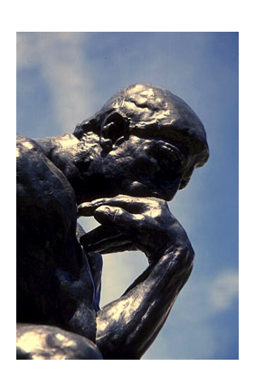
The Humanist Approach

Slide 2
Remember to only write down the notes that are
bold and underlined.

Slide 3
In our next topic we will delve into the Renaissance, and what made the thinking, art, writing, ideas and education of this time period unique. First, let's take a look at where we last left off:
-Europe (in particular Italy) was trading with other cultures
-Trade increased contact with other cultures
-Contact with other cultures exposed Europeans to new ideas
-Europeans began to want to develop their minds and talents in order to use them for the good of society

Slide 4
Terms
HUMANIST: a person who adopts a system of thought that centres on humans and their values, capacities and worth; concern with the interests, needs and welfare of humans
PHILOSOPHERS: someone who studies human conduct, human knowledge and the nature of the universe
DEMOCRACY: A form of government in which people elect (vote) representatives to rule the country

Slide 5
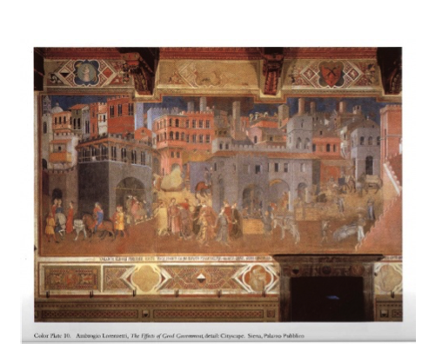
Terms Continued
Civic: Relating to citizenship or your role within government
Patrons: people who pay artists to produce artwork

Slide 6
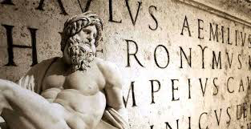
Events:
Humanism began in Italy when scholars looked back to the ancient Greeks and Romans. These scholars studied the classical writings and art from the Ancient times. They knew that the ancient language of latin was still used in the Catholic church.
Scholars began to become interested in the ideas that ancient civilizations had about society, politics, history and the arts.

Slide 7
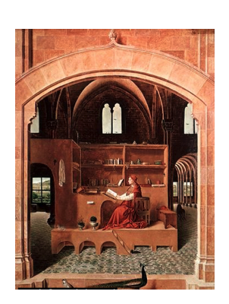
Events Continued:
Humanist ideas spread among the wealthy and the Middle Class. It became trendy to study the ancient civilizations.
Civic Humanists encouraged Europeans to get involved with their government by educating themselves about history and political issues.

Slide 8
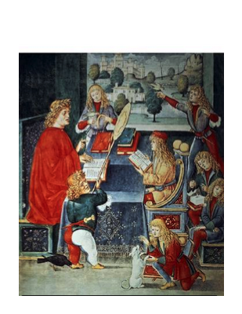
Events Continued
Education became very important to Humanists. They started up their own schools where Humanist thinking was a focus.
They studied Greek and Roman classical writing. Other subjects included physical training, ethics and morality (right and wrong), history and manners. They also studied grammar, math, music and religion which had been studied in the Middle Ages.

Slide 9
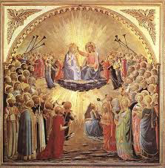
Events Continued
The Catholic religion remained important to Humanists and to Europeans.
Art became very important to Humanists, as it was a way to express their thoughts on human beings. Most art during the Renaissance had religious themes.

Slide 10
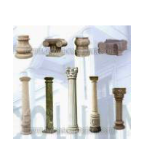
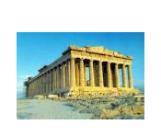
Events Continued
Europeans began to focus on including features of classical (ancient) buildings in their architecture. Some of these features included pillars, columns and domes.
Architects began to be thought of as an artist who designs buildings, rather than a labourer.

Slide 11
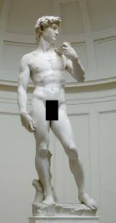
Ideas/Concepts
Humanism is based on many ideas from the ancient Greeks and Romans. Some key ideas and achievements from the ancient civilizations are:
-Poetry, drama, and sculpture
-Architecture
-Had brilliant mathematicians and philosophers
-Developed the Olympic games
-Developed democracy
Statue of David is a Renaissance Statue based off of statues of Ancient Greece.

Slide 12
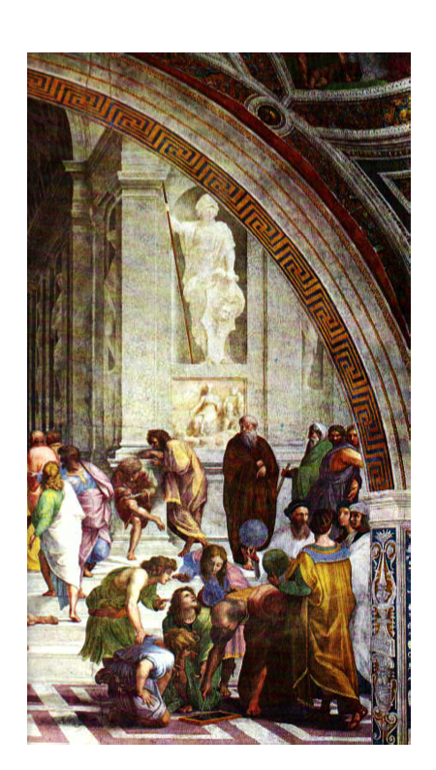
Ideas/Concepts Continued
The main idea of Humanism was the power of the individual. Humanists believed that people could shape their lives their own efforts and talents. Humanism was integrated with the Catholic/Christian worldview: if you developed your own talents, you were also serving God because God had given you those talents.

Slide 13
Ideas/Concepts Continued
The main points of Humanism were:
-Humans can/should use the power of reason (thinking)
-It is important to have an open and curious mind
-Education is extremely important
-People should become skilled in many different ways: mind, body and spirit

Slide 14
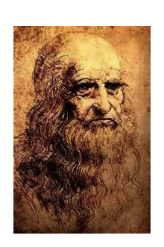
Who:
Leonardo da Vinci was an extremely important figure in the Renaissance. He is most famous for his art, however he was also an inventor.
Leonardo da Vinci painted the Mona Lisa.

Slide 15
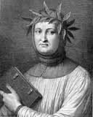
Who Continued:
Francesco Petrarch was a humanist thinker of the early Renaissance.
Francesco believed that the ancient times long before the Renaissance were far superior to the Middle or Dark ages. He collected ancient manuscripts (writings/books) in libraries in the Muslim World, monasteries and Cathedrals where they had been preserved.
He copied and wrote out these manuscripts so others could read them. He felt to be truly cultured, a person should read these books and study great works of art.

Slide 16
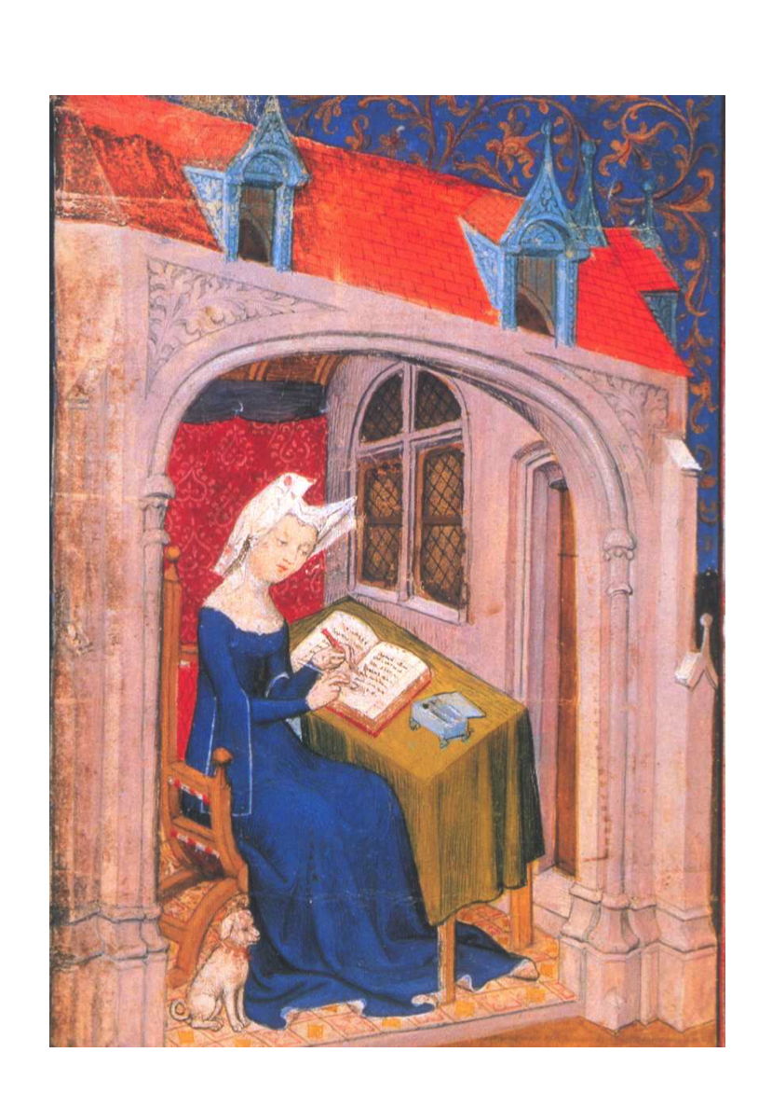
Who Continued
Christine di Pisan was one of the few female humanists. She was Europe's first professional woman writer. She wrote poetry, history, essays, and biographies.
The main theme of her work was that she wanted women and men to not be judged on their gender but their abilities.

Slide 17
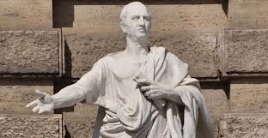
Who Continued
Cicero was a Roman lawyer and politician from ancient times. He believed public service was the duty of everyone in society.

Slide 18
Worldviews:
-The Renaissance worldview of Humanism was a result of intercultural contact with earlier civilizations (through writings, art etc.)
-Humanism was integrated with the Catholic/Christian worldview: if you developed your own talents, you were also serving God because God had given you those talents.
Example
Worldview of Renaissance Europe: It is important to develop your talents in mind, body and spirit so that you can best serve society and God.

